Slide 1
System Programming and Compiler Construction (Course Code - CE61) Lecture #11
Dr. Anant V Nimkar PhD(CSE-IIT Kharagpur)
Associate Professor
Department of Computer Engineering
Sardar Patel Institute of Technology Mumbai

Slide 2
Top-Down Parsing
Types of Parsing Methods
Top-Down Parsing
Bottom-Up Parsing
Top-Down Parsing
Recursive-Descent Parsing
LL(1) & Non-recursive Predictive Parsing

Slide 3
Parsing methods
Parsing
Top down parsing
Bottom up parsing (Shift reduce)
Back tracking
Operator precedence
Parsing without backtracking (predictive parsing)
LR parsing
SLR
LL(1)
CLR
Recursive
descent
LALR

Slide 4
LL(1) Parser (Non-recursive Predictive Parsing)
LL(1) is non recursive top down parser.
First L indicates input is scanned from left to right.
The second L means it uses leftmost derivation for input string
1 means it uses only input symbol to predict the parsing process.
a | + | b | $
INPUT
X
Y
Z
$
Predictive parsing program
Stack
OUTPUT
Parsing table M

Slide 5
LL(1) parsing (predictive parsing)
Steps to construct LL(1) parser
Remove left recursion / Perform left factoring (if any).
Compute FIRST and FOLLOW of non terminals.
Construct predictive parsing table.
Parse the input string using parsing table.

Slide 6
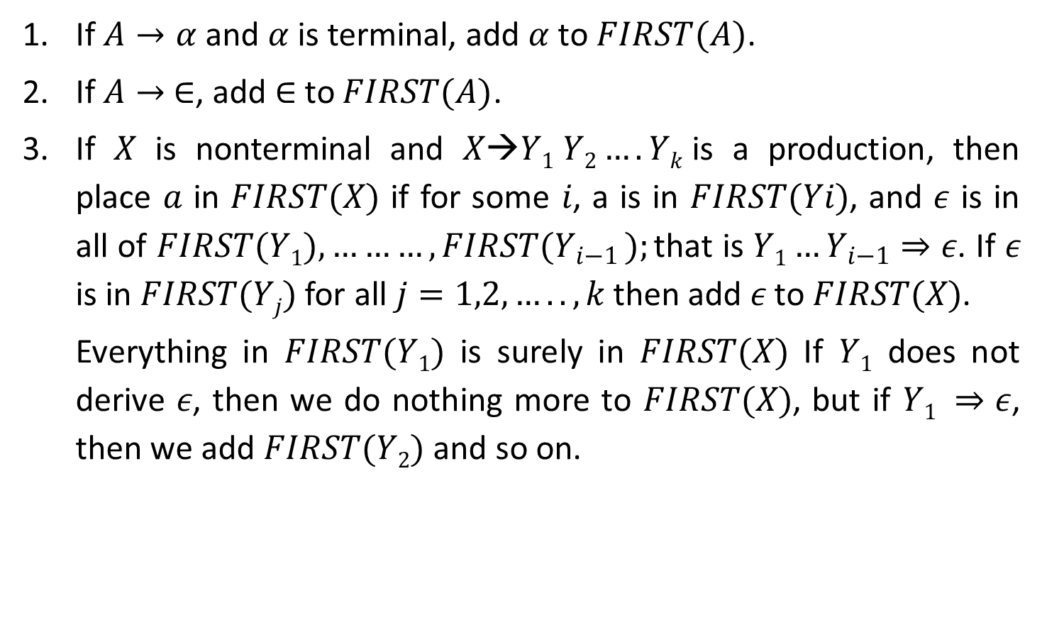
Rules to compute first of non terminal
If $A→α$and $α$ is terminal, add $α$ to $FIRST(A)$.
If $A→ ∈$, add $∈$to $FIRST(A)$.
If $X$ is nonterminal and $X→Y1 Y2….Yk$is a production, then place $a$ in $FIRST(X)$ if for some $i$, a is in $FIRST(Yi)$, and 𝜖 is in all of $FIRST(Y1),………,FIRST(Y_{i−1} );$that is $Y1…Y_{i−1}⇒ε$. If 𝜖 is in $FIRST(Yj)$ for all $j=1,2,…..,k$then add 𝜖 to $FIRST(X)$.
Everything in $FIRST(Y1)$ is surely in $FIRST(X)$ If $Y1$ does not derive 𝜖, then we do nothing more to $FIRST(X)$, but if $Y1 ⇒ε$, then we add $FIRST(Y2)$ and so on.
*
*

Slide 7
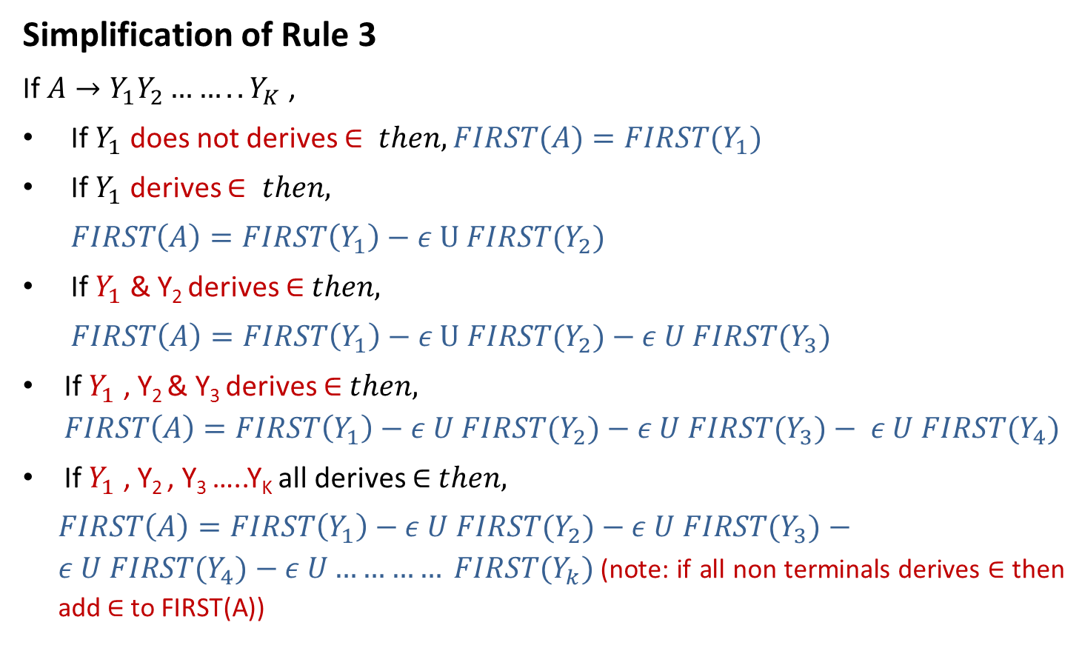
Rules to compute first of non terminal
Simplification of Rule 3
If $A→Y_{1}Y_{2}……..Y_{K}$ ,
If $Y_{1}$does not derives $∈ then, FIRST(A)=FIRST{(Y}_{1})$
If $Y_{1}$derives $∈ then,$
$FIRST\left(A\right)=FIRST\left(Y_{1}\right)−ε U FIRST{(Y}_{2})$
If $Y_{1}$& Y₂ derives ∈$then,$
$FIRST\left(A\right)=FIRST\left(Y_{1}\right)−ε U FIRST{(Y}_{2})$$− ε U FIRST{(Y}_{3})$
If $Y_{1}$, Y₂ & Y₃derives ∈$then,$
$$FIRST\left(A\right)=FIRST\left(Y_{1}\right)−ε U FIRST{(Y}_{2})−ε U FIRST{(Y}_{3})− ε U FIRST{(Y}_{4})$$
If $Y_{1}$ , Y₂ , Y₃ …..Y_{K}all derives ∈ $then,$
$FIRST\left(A\right)=FIRST\left(Y_{1}\right)−ε U FIRST{(Y}_{2})−ε U FIRST{(Y}_{3})−ε U FIRST{(Y}_{4})−ε U………… FIRST{(Y}_{k})$(note: if all non terminals derives ∈ then add ∈ to FIRST(A))

Slide 8

Rules to compute FOLLOW of non terminal
Place $\$ in follow\left(S\right). ($S is start symbol)
If $A→αBβ ,$then everything in $FIRST(β)$ except for 𝜖 is placed in$FOLLOW(B)$
If there is a production$A→αB$ or a production $A→αBβ$ where $FIRST(β)$contains $ε$ then everything in $FOLLOW\left(A\right)=FOLLOW\left(B\right)$

Slide 9











How to apply rules to find FOLLOW of non terminal?
$$A→αBβ$$
$$β is absent$$
$$β is present$$
$$Rule 3$$
$$β is terminal$$
$$β is Nonterminal$$
$$Rule 2$$
$β does not derives$𝜖
$β derives$𝜖
$$Rule 2$$
$$Rule 2+Rule 3$$

Slide 10
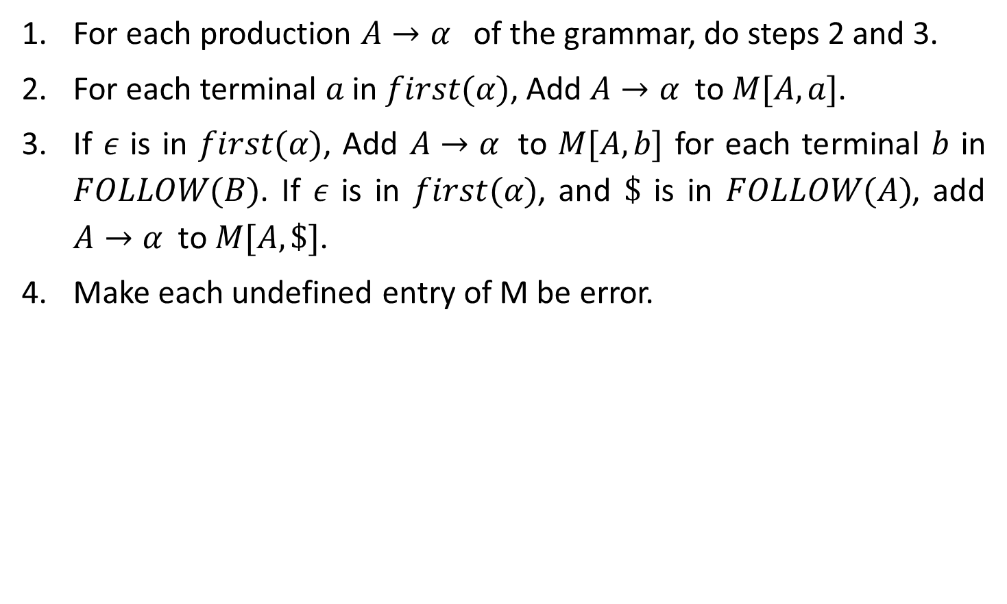
Rules to construct predictive parsing table
For each production $A→α$ of the grammar, do steps 2 and 3.
For each terminal $a$ in $first(α)$, Add $A→α$ to $M[A,a]$.
If $ε$ is in $first(α)$, Add $A→α$ to $M[A,b]$ for each terminal $b$ in $FOLLOW(B)$. If $ε$is in $first(α)$, and $\$$ is in $FOLLOW(A)$,add $A→α$ to $M[A,\$]$.
Make each undefined entry of M be error.

Slide 11
Example: LL(1) parsing
E→E+T | T
T→T*F | F
F→(E) | id
Step 1: Remove left recursion
E→TE’
E’→+TE’ | ϵ
T→FT’
T’→*FT’ | ϵ
F→(E) | id

Slide 12




Example: LL(1) parsing
Step 2: Compute FIRST
First(E)
E→TE’
First(T)
T→FT’
First(F)
F→(E) F→id
E→TE’
E’→+TE’ | ϵ
T→FT’
T’→*FT’ | ϵ
F→(E) | id
E | → | T | E’
Rule 3
First(A)=First(Y1)
A | → | Y₁ | Y₂
FIRST(E)=FIRST(T)
= {(, id }
NT | First
E | { (,id }
E’
T | → | F | T’
Rule 3
First(A)=First(Y1)
T | { (,id }
A | → | Y₁ | Y₂
T’
FIRST(T)=FIRST(F)
= {(, id }
F | { (,id }
F | → | ( | E | )
F | → | id
A | → | $$α$$
Rule 1
add $α$ to $FIRST(A)$
A | → | $$α$$
Rule 1
add $α$ to $FIRST(A)$
FIRST(F)={ (
, id }

Slide 13


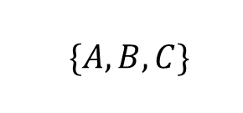


Example: LL(1) parsing
Step 2: Compute FIRST
First(E’)
E’→+TE’
E’→𝜖
E→TE’
E’→+TE’ | ϵ
T→FT’
T’→*FT’ | ϵ
F→(E) | id
E’ | → | + | T | E’
Rule 1
add $α$ to $FIRST(A)$
NT | First
A | → | $$α$$
E | { (,id }
E’ | { +, 𝜖 }
T | { (,id }
T’
E’ | → | $$ε$$
Rule 2
add $ε$to $FIRST(A)$
F | { (,id }
A | → | $$ε$$
FIRST(E’)={ +
, 𝜖 }

Slide 14



Example: LL(1) parsing
Step 2: Compute FIRST
First(T’)
T’→*FT’
T’→𝜖
E→TE’
E’→+TE’ | ϵ
T→FT’
T’→*FT’ | ϵ
F→(E) | id
T’ | → | * | F | T’
Rule 1
add $α$ to $FIRST(A)$
NT | First
A | → | $$α$$
E | { (,id }
E’ | { +, 𝜖 }
T | { (,id }
T’ | { *, 𝜖 }
T’ | → | $$ε$$
Rule 2
add $ε$to $FIRST(A)$
F | { (,id }
A | → | $$ε$$
FIRST(T’)={ *
, 𝜖 }

Slide 15

Example: LL(1) parsing
Step 2: Compute FOLLOW
FOLLOW(E)
F→(E)
E→TE’
E’→+TE’ | ϵ
T→FT’
T’→*FT’ | ϵ
F→(E) | id
Rule 1: Place $ in FOLLOW(E)
NT | First | Follow
E | { (,id } | { $,) }
E’ | { +, 𝜖 }
F | → | ( | E | )
Rule 2
T | { (,id }
A | → | $$α$$ | B | $$β$$
T’ | { *, 𝜖 }
F | { (,id }
FOLLOW(E)={ $,
) }

Slide 16


Example: LL(1) parsing
Step 2: Compute FOLLOW
FOLLOW(E’)
E→TE’
E’→+TE’
E→TE’
E’→+TE’ | ϵ
T→FT’
T’→*FT’ | ϵ
F→(E) | id
NT | First | Follow
E | → | T | E’
Rule 3
E | { (,id } | { $,) }
A | → | $$α$$ | B
E’ | { +, 𝜖 } | { $,) }
T | { (,id }
T’ | { *, 𝜖 }
F | { (,id }
E’ | → | +T | E’
Rule 3
A | → | $$α$$ | B
}
FOLLOW(E’)={ $,)

Slide 17


Example: LL(1) parsing
Step 2: Compute FOLLOW
FOLLOW(T)
E→TE’
E→TE’
E’→+TE’ | ϵ
T→FT’
T’→*FT’ | ϵ
F→(E) | id
NT | First | Follow
E | → |  | T | E’
Rule 2
E | { (,id } | { $,) }
A | → | $$α$$ | B | $$β$$
E’ | { +, 𝜖 } | { $,) }
T | { (,id }
T’ | { *, 𝜖 }
F | { (,id }
E | → |  | T | E’
Rule 3
A | → | $$α$$ | B | $$β$$
FOLLOW(T)={ +,
$, )

Slide 18


Example: LL(1) parsing
Step 2: Compute FOLLOW
FOLLOW(T)
E’→+TE’
E→TE’
E’→+TE’ | ϵ
T→FT’
T’→*FT’ | ϵ
F→(E) | id
NT | First | Follow
E’ | → | + | T | E’
Rule 2
E | { (,id } | { $,) }
A | → | $$α$$ | B | $$β$$
E’ | { +, 𝜖 } | { $,) }
T | { (,id } | { +,$,) }
T’ | { *, 𝜖 }
F | { (,id }
E’ | → | + | T | E’
Rule 3
A | → | $$α$$ | B | $$β$$
}
FOLLOW(T)={ +,
$, )

Slide 19
Example: LL(1) parsing
Step 2: Compute FOLLOW
FOLLOW(T’)
T→FT’
T’→*FT’
E→TE’
E’→+TE’ | ϵ
T→FT’
T’→*FT’ | ϵ
F→(E) | id
NT | First | Follow
T | → | F | T’
Rule 3
E | { (,id } | { $,) }
A | → | $$α$$ | B
E’ | { +, 𝜖 } | { $,) }
T | { (,id } | { +,$,) }
T’ | { *, 𝜖 } | { +,$,) }
F | { (,id }
T’ | → | *F | T’
Rule 3
A | → | $$α$$ | B
}
FOLLOW(T’)={+ $,)

Slide 20

Example: LL(1) parsing
Step 2: Compute FOLLOW
FOLLOW(F)
T→FT’
E→TE’
E’→+TE’ | ϵ
T→FT’
T’→*FT’ | ϵ
F→(E) | id
NT | First | Follow
T | → |  | F | T’
Rule 2
E | { (,id } | { $,) }
A | → | $$α$$ | B | $$β$$
E’ | { +, 𝜖 } | { $,) }
T | { (,id } | { +,$,) }
T’ | { *, 𝜖 } | { +,$,) }
F | { (,id }
T | → |  | F | T’
Rule 3
A | → | $$α$$ | B | $$β$$
FOLLOW(F)={ *,
+ ,$ , )

Slide 21
Example: LL(1) parsing
Step 2: Compute FOLLOW
FOLLOW(F)
T’→*FT’
E→TE’
E’→+TE’ | ϵ
T→FT’
T’→*FT’ | ϵ
F→(E) | id
NT | First | Follow
T’ | → | * | F | T’
Rule 2
E | { (,id } | { $,) }
A | → | $$α$$ | B | $$β$$
E’ | { +, 𝜖 } | { $,) }
T | { (,id } | { +,$,) }
T’ | { *, 𝜖 } | { +,$,) }
F | { (,id } | {*,+,$,)}
T’ | → | * | F | T’
Rule 3
A | → | $$α$$ | B | $$β$$
}
FOLLOW(F)={ *,+,
$, )

Slide 22

Example: LL(1) parsing
Step 3: Construct predictive parsing table
E→TE’
a=FIRST(TE’)={ (,id }
M[E,(]=E→TE’
M[E,id]=E→TE’
NT | Input Symbol
 | id | + | * | ( | ) | $
E | E→TE’ |  |  | E→TE’
E’
T
T’
F
NT | First | Follow
E | { (,id } | { $,) }
E’ | { +, 𝜖 } | { $,) }
T | { (,id } | { +,$,) }
T’ | { *, 𝜖 } | { +,$,) }
F | { (,id } | {*,+,$,)}
Rule: 2
A→$α$
a = first($α$)
M[A,a] = A→$α$
E→TE’
E’→+TE’ | ϵ
T→FT’
T’→*FT’ | ϵ
F→(E) | id

Slide 23
Example: LL(1) parsing
Step 3: Construct predictive parsing table
E’→+TE’
a=FIRST(+TE’)={ + }
M[E’,+]=E’→+TE’
NT | Input Symbol
 | id | + | * | ( | ) | $
E | E→TE’ |  |  | E→TE’
E’ |  | E’→+TE’
T
T’
F
NT | First | Follow
E | { (,id } | { $,) }
E’ | { +, 𝜖 } | { $,) }
T | { (,id } | { +,$,) }
T’ | { *, 𝜖 } | { +,$,) }
F | { (,id } | {*,+,$,)}
Rule: 2
A→$α$
a = first($α$)
M[A,a] = A→$α$
E→TE’
E’→+TE’ | ϵ
T→FT’
T’→*FT’ | ϵ
F→(E) | id

Slide 24

Example: LL(1) parsing
Step 3: Construct predictive parsing table
E’→𝜖
b=FOLLOW(E’)={ $,) }
M[E’,$]=E’→𝜖
M[E’,)]=E’→𝜖
NT | Input Symbol
 | id | + | * | ( | ) | $
E | E→TE’ |  |  | E→TE’
E’ |  | E’→+TE’ |  |  | E’→𝜖 | E’→𝜖
T
T’
F
NT | First | Follow
E | { (,id } | { $,) }
E’ | { +, 𝜖 } | { $,) }
T | { (,id } | { +,$,) }
T’ | { *, 𝜖 } | { +,$,) }
F | { (,id } | {*,+,$,)}
Rule: 3
A→$α$
b = follow(A)
M[A,b] = A→$α$
E→TE’
E’→+TE’ | ϵ
T→FT’
T’→*FT’ | ϵ
F→(E) | id

Slide 25
Example: LL(1) parsing
Step 3: Construct predictive parsing table
T→FT’
a=FIRST(FT’)={ (,id }
M[T,(]=T→FT’
M[T,id]=T→FT’
NT | Input Symbol
 | id | + | * | ( | ) | $
E | E→TE’ |  |  | E→TE’
E’ |  | E’→+TE’ |  |  | E’→𝜖 | E’→𝜖
T | T→FT’ |  |  | T→FT’
T’
F
NT | First | Follow
E | { (,id } | { $,) }
E’ | { +, 𝜖 } | { $,) }
T | { (,id } | { +,$,) }
T’ | { *, 𝜖 } | { +,$,) }
F | { (,id } | {*,+,$,)}
Rule: 2
A→$α$
a = first($α$)
M[A,a] = A→$α$
E→TE’
E’→+TE’ | ϵ
T→FT’
T’→*FT’ | ϵ
F→(E) | id

Slide 26
Example: LL(1) parsing
Step 3: Construct predictive parsing table
T’→*FT’
a=FIRST(*FT’)={ * }
M[T’,*]=T’→*FT’
NT | Input Symbol
 | id | + | * | ( | ) | $
E | E→TE’ |  |  | E→TE’
E’ |  | E’→+TE’ |  |  | E’→𝜖 | E’→𝜖
T | T→FT’ |  |  | T→FT’
T’ |  |  | T’→*FT’
F
NT | First | Follow
E | { (,id } | { $,) }
E’ | { +, 𝜖 } | { $,) }
T | { (,id } | { +,$,) }
T’ | { *, 𝜖 } | { +,$,) }
F | { (,id } | {*,+,$,)}
Rule: 2
A→$α$
a = first($α$)
M[A,a] = A→$α$
E→TE’
E’→+TE’ | ϵ
T→FT’
T’→*FT’ | ϵ
F→(E) | id

Slide 27
Example: LL(1) parsing
Step 3: Construct predictive parsing table
T’→𝜖
b=FOLLOW(T’)={ +,$,) }
M[T’,+]=T’→𝜖
M[T’,$]=T’→𝜖
M[T’,)]=T’→𝜖
NT | Input Symbol
 | id | + | * | ( | ) | $
E | E→TE’ |  |  | E→TE’
E’ |  | E’→+TE’ |  |  | E’→𝜖 | E’→𝜖
T | T→FT’ |  |  | T→FT’
T’ |  | T’→𝜖 | T’→*FT’ |  | T’→𝜖 | T’→𝜖
F
NT | First | Follow
E | { (,id } | { $,) }
E’ | { +, 𝜖 } | { $,) }
T | { (,id } | { +,$,) }
T’ | { *, 𝜖 } | { +,$,) }
F | { (,id } | {*,+,$,)}
Rule: 3
A→$α$
b = follow(A)
M[A,b] = A→$α$
E→TE’
E’→+TE’ | ϵ
T→FT’
T’→*FT’ | ϵ
F→(E) | id

Slide 28
Example: LL(1) parsing
Step 3: Construct predictive parsing table
F→(E)
a=FIRST((E))={ ( }
M[F,(]=F→(E)
NT | Input Symbol
 | id | + | * | ( | ) | $
E | E→TE’ |  |  | E→TE’
E’ |  | E’→+TE’ |  |  | E’→𝜖 | E’→𝜖
T | T→FT’ |  |  | T→FT’
T’ |  | T’→𝜖 | T’→*FT’ |  | T’→𝜖 | T’→𝜖
F |  |  |  | F→(E)
NT | First | Follow
E | { (,id } | { $,) }
E’ | { +, 𝜖 } | { $,) }
T | { (,id } | { +,$,) }
T’ | { *, 𝜖 } | { +,$,) }
F | { (,id } | {*,+,$,)}
Rule: 2
A→$α$
a = first($α$)
M[A,a] = A→$α$
E→TE’
E’→+TE’ | ϵ
T→FT’
T’→*FT’ | ϵ
F→(E) | id

Slide 29
Example: LL(1) parsing
Step 3: Construct predictive parsing table
F→id
a=FIRST(id)={ id }
M[F,id]=F→id
NT | Input Symbol
 | id | + | * | ( | ) | $
E | E→TE’ |  |  | E→TE’
E’ |  | E’→+TE’ |  |  | E’→𝜖 | E’→𝜖
T | T→FT’ |  |  | T→FT’
T’ |  | T’→𝜖 | T’→*FT’ |  | T’→𝜖 | T’→𝜖
F | F→id |  |  | F→(E)
NT | First | Follow
E | { (,id } | { $,) }
E’ | { +, 𝜖 } | { $,) }
T | { (,id } | { +,$,) }
T’ | { *, 𝜖 } | { +,$,) }
F | { (,id } | {*,+,$,)}
Rule: 2
A→$α$
a = first($α$)
M[A,a] = A→$α$
E→TE’
E’→+TE’ | ϵ
T→FT’
T’→*FT’ | ϵ
F→(E) | id

Slide 30
Example: LL(1) parsing
Step 4: Make each undefined entry of table be Error
NT | Input Symbol
 | id | + | * | ( | ) | $
E | E→TE’ | Error | Error | E→TE’ | Error | Error
E’ | Error | E’→+TE’ | Error | Error | E’→𝜖 | E’→𝜖
T | T→FT’ | Error | Error | T→FT’ | Error | Error
T’ | Error | T’→𝜖 | T’→*FT’ | Error | T’→𝜖 | T’→𝜖
F | F→id | Error | Error | F→(E) | Error | Error
NT | First | Follow
E | { (,id } | { $,) }
E’ | { +, 𝜖 } | { $,) }
T | { (,id } | { +,$,) }
T’ | { *, 𝜖 } | { +,$,) }
F | { (,id } | {*,+,$,)}
E→TE’
E’→+TE’ | ϵ
T→FT’
T’→*FT’ | ϵ
F→(E) | id

Slide 31
Example: LL(1) parsing
Step 4: Parse the string : id + id * id $
STACK | INPUT | OUTPUT
NT | Input Symbol
 | id | + | * | ( | ) | $
E | E→TE’ | Error | Error | E→TE’ | Error | Error
E’ | Error | E’→+TE’ | Error | Error | E’→𝜖 | E’→𝜖
T | T→FT’ | Error | Error | T→FT’ | Error | Error
T’ | Error | T’→𝜖 | T’→*FT’ | Error | T’→𝜖 | T’→𝜖
F | F→id | Error | Error | F→(E) | Error | Error
E$ | id+id*id$
TE’$ | id+id*id$ | E→TE’
FT’E’$ | id+id*id$ | T→FT’
idT’E’$ | id+id*id$ | F→id
T’E’$ | +id*id$
E’$ | +id*id$ | T’→𝜖
+TE’$ | +id*id$ | E’→+TE’
TE’$ | id*id$
FT’E’$ | id$
FT’E’$ | id*id$ | T→FT’
idT’E’$ | id$ | F→id
idT’E’$ | id*id$ | F→id
T’E’$ | $
T’E’$ | *id$
E’$ | $ | T’→𝜖
*FT’E’$ | *id$ | T→*FT’
$ | $ | E’→𝜖

Slide 32


